Slide 1
INTRODUCTION TO DOCKER

Slide 2
Learning Objectives:
What is Docker?
How to create Docker images.
How to map ports between Docker and the Host OS.
The basics of Docker networking.
How to use volumes for persistent storage.
How to tag images.

Slide 3
What is Docker?
Docker is a container platform that bundles your code and all its dependencies into a self contained entity that can run on any supported system.
Single executable for all your code.
Docker daemon:- The Docker daemon listens for Docker API requests and manages Docker objects such as images, containers, networks, and volumes. A daemon can also communicate with other daemons to manage Docker services.

Slide 4
Docker Architecture
Docker follows a client-server architecture :-
Where the docker daemon acts as the server and docker binaries acts as the client.

Slide 5
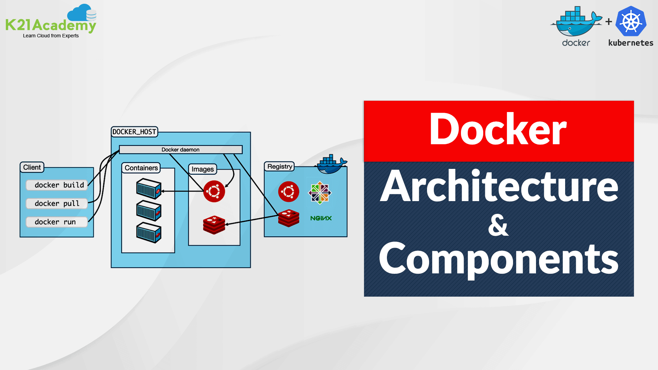

Slide 6
Docker Technologies
Namespaces
Control groups
UnionFS

Slide 7
Namespaces
Namespace allows you to isolate system resources.
pid namespace:- Process isolation (PID : process id)
net namespace:- Managing network interfaces(NET : Networking)
ipc namespace:- Managing access to IPC resources (IPC : Inter Process Communication).
mnt namespace:- Managing filesystem mount points (mnt : Mount).
uts namespace:- Isolating kernel and version identifiers. (UTS : Unix Timesharing System)

Slide 8
Control groups
Resource limiting:- groups can be set to not exceed a configured memory limit.
Prioritization:- some groups may get a larger share of CPU utilization or disk I/O throughput.
Accounting:- measures a group’s resource usage.
Control:- freezing groups of processes.

Slide 9
UnionFS
UnionFS (Union File System):-when u launch a container, u will be in the first layer. When u keep on adding the packages, new layers will be created.
In order to keep all the changes in one layer, docker has a function called merging (where all the branches are merged to one).
Merging:- overlay filesystem branches to merge changes.
Read/Write:- branches can be read-only or read-write.

Slide 10
Docker images
We need docker images for running the containers.
The basic docker images are found in docker store inside the docker hub.
If we want to create a custom docker image, we can either go for building a Dockerfile or can commit the existing container.

Slide 11
Port Mapping
Even though the containers have individual ip, but when we try to access a container, we need to use ip of the base OS. So, we go for Mapping, because ip of container exists only for that local machine but not to the external world.
Docker run –it –p [base OS’s ip]:[Container ip] –d image

Slide 12
Docker Networking
Bridge: When you create a container without specifying the network, by default docker opts bridge.
Host: Adds the container to the host’s network. (Host network has no isolation between host and the container.
Whatever the ports needed to opened in container are opened in host.
docker run –d –network=host image name/application
None: As the name itself indicates, no network connection is enabled.
Command to check networks: docker network ls

Slide 13
Docker Storage options
Bind Mounts: Here we decide the path on host file system which can be mounted with the containers.
Docker volumes: When you use a bind mount, a file or directory on the host machine is mounted into a container. When you use a volume, a new directory is created within Docker's storage directory on the host machine, and Docker manages that directory's contents.

Slide 14
docker run -p 8080:8080 -p 50000:50000 --mount /your/home:/var/jenkins_home jenkins/jenkins (mounts to host’s directory).
docker run -p 8080:8080 -p 50000:50000 –v voulme1:/var/jenkins_home jenkins/jenkins (volume attached to host’s directory with specified name).
docker run -p 8080:8080 -p 50000:50000 –v /var/jenkins_home jenkins/jenkins (volume attached to host’s directory an0nymous volume).

Slide 15
Image Tags
Tags are named references to docker images. They make it easy to pull and run images, and for image authors to roll out updates automatically.
Through the tag, we can specify or identify the versions of an image.
If you don’t provide a tag, docker automatically uses a default tag called latest.
Tagging an image:-
docker tag tag_demo:latest tag_demo:new_tag_name

